Slide 1
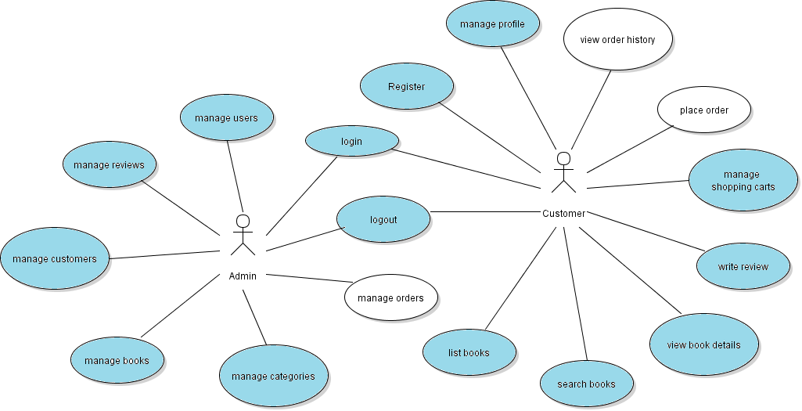
Implement Place Order Feature

Slide 2
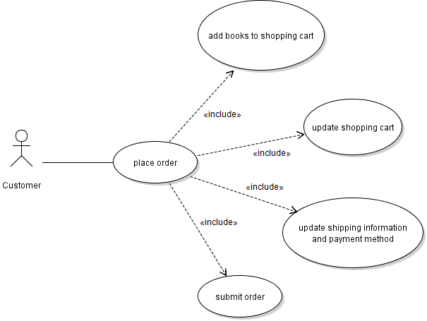
Use Case: Place Order

Slide 3
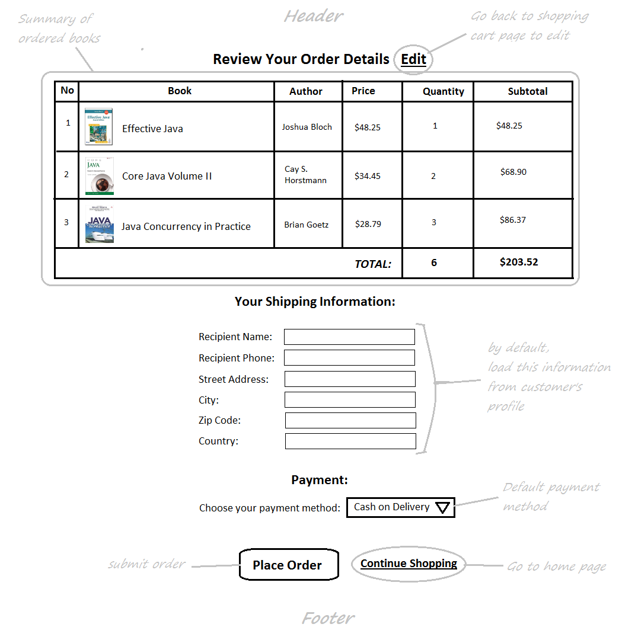
Check Out Page

Slide 4
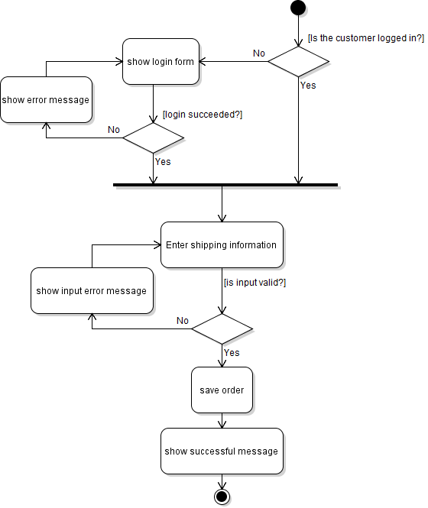
Activity Diagram: Place Order

Slide 5
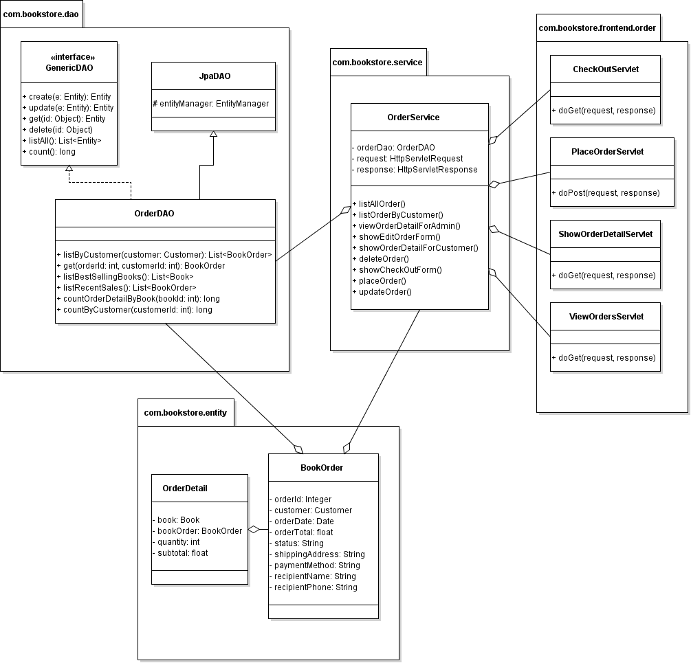
Class Diagram

Slide 6
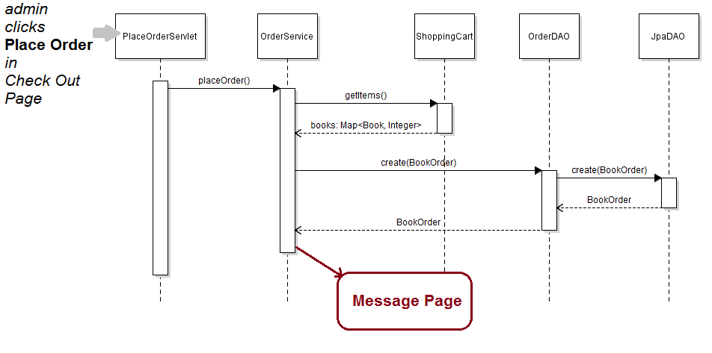
Sequence Diagram: Place Order

Slide 7
Implement Place Order Feature
Create CheckOutServlet
Code Check Out Page
Create PlaceOrderServlet
Update OrderServices
Update CustomerLoginFilter

